Slide 1

power efficient approximate 4:2 compressors for imprecise multipliers
Presented by:
SIDDHARTH SINGH UPADHYAY
M.TECH IN VLSI & Embedded system

Slide 2
CONTENTS
INTRODUCTION
PROPOSED 4:2 COMPRESSOR MODEL
MINIMIZE CIRCUIT
SUM
CARRY
COUT
APPROXIMATED 4:2 COMPRESSOR
4:2 COMPRESSOR USING MULTIPLIER CIRCUIT
TRASISTOR COUNT OF 4:2 COMPRESSOR
AVG POWER, DELAY AND AREA OF 4:2 COMPRESSOR
ERROR MATRICS OF 4:2 COMPRESSOR
ERROR ANALYSIS OF MULTIPLIERS
CONCLUSION

Slide 3
Introduction
low power consumption and smaller silicon area are the critical parameters in portable devices, approximate circuits have been the current topic for discussion.
This paper presents a 4:2 compressors with inexact logic minimization by flipping some of the output bits considering efficiency/accuracy into account.
The proposed 4:2 compressor has been utilized in an 8 × 8 Dadda multiplier and average power, area and propagation delay of the architectures have been computed.

Slide 4
PROPOSED 4:2 COMPRESSOR MODEL
This research work employs probabilistic logic minimization on exact 4:2 compressor, where bit flipping in the min terms of Boolean functions of SUM, Carry and Cout is done to minimize the number of literals, thereby reducing power consumption, area and delay of the circuit.
identify the favorable bit flips, different combinations are attempted at the expense of error which is proportional to the number of bit flips introduced.
After implementing this process on any exact circuit, the size of the circuitry should decrease with less error rate.

Slide 5
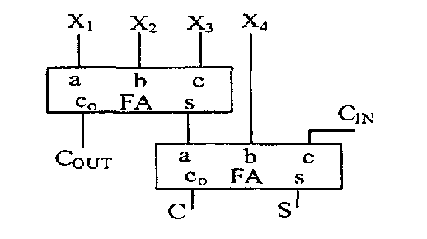
in this paper ‘1 to 0’ is chosen to reduce the size of the circuitry. Cout, Carry, SUM bits are flipped by 8, 4, 8 in number respectively
EXACT 4:2 compressor circuit:-

Slide 6
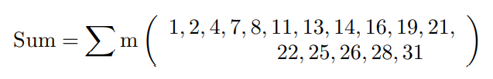
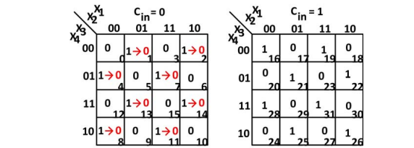
MINIMIZE CIRCUIT
SUM
The actual min terms of SUM in exact 4:2 compressor is given by
SUM: a) Lower Order bits flips to ‘0’ b) Exact Higher Order bits.

Slide 7
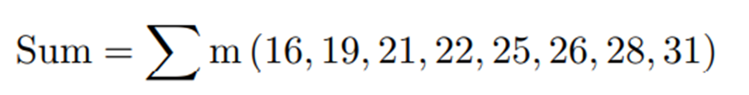
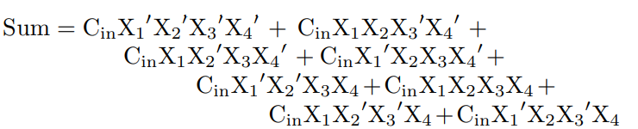
After flipping lower order bits, the Boolean function of SUM is reduced to
For this approximated SUM, the Boolean expression is represented as

Slide 8
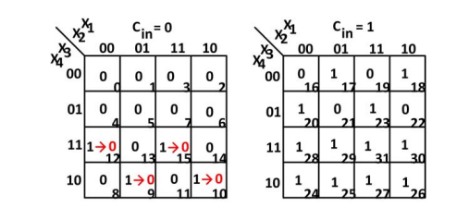
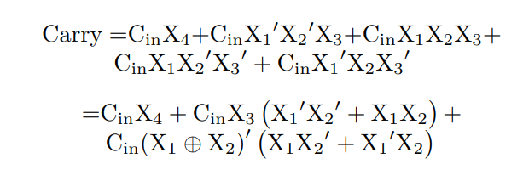
For CARRY
The actual min terms of Carry in exact 4:2 compressor is given by eq
After making lower order bits zeros, the carry min terms are reduced to

Slide 9
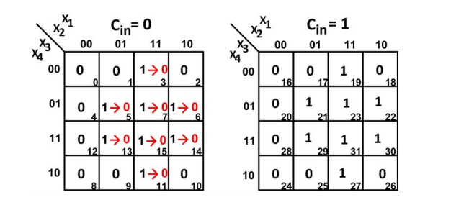
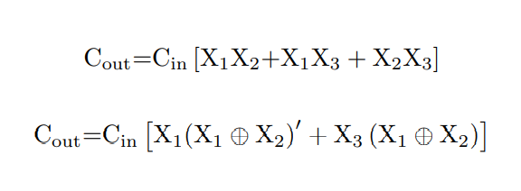
FOR COUT
Cout:a) Lower Order bits flips to ‘0’ b) Exact Higher Order bits

Slide 10
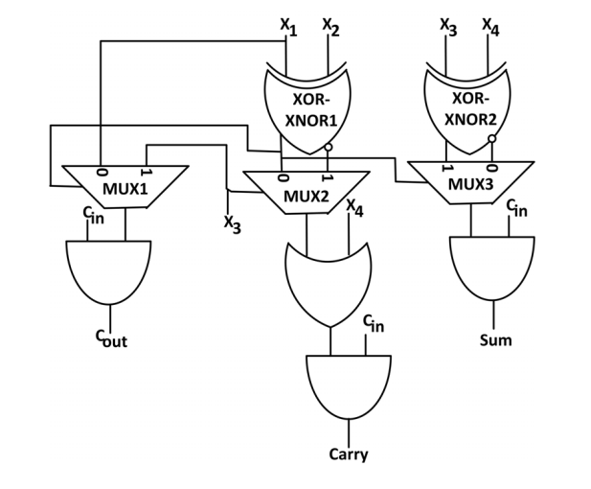
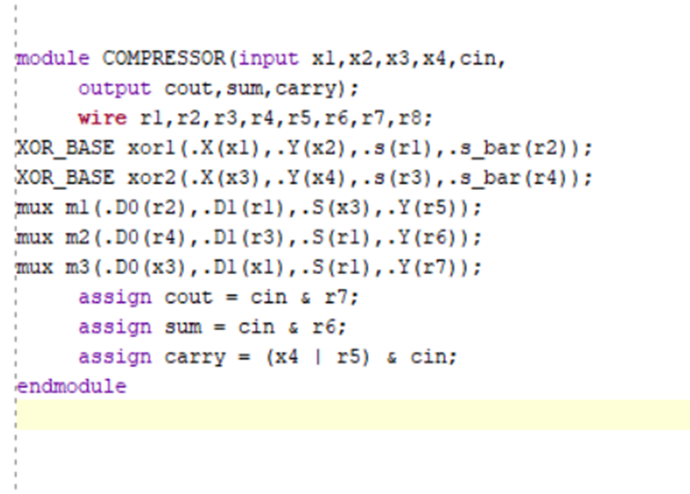
APPROXIMATED 4:2 COMPRESSOR
From the above approximated equations, the proposed approximated 4:2 compressor is obtained as in Fig

Slide 11
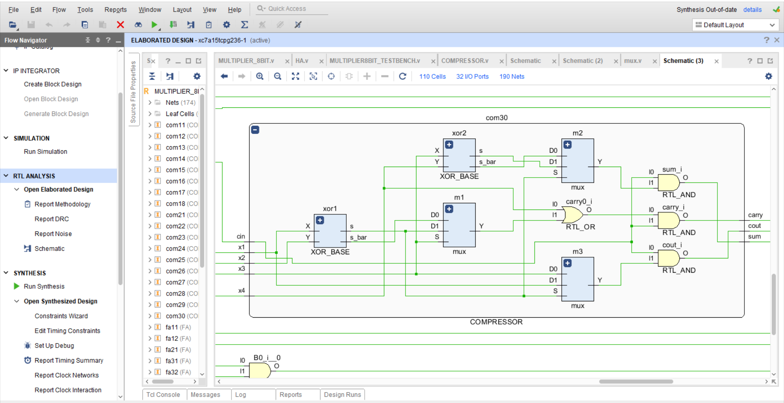

Slide 12
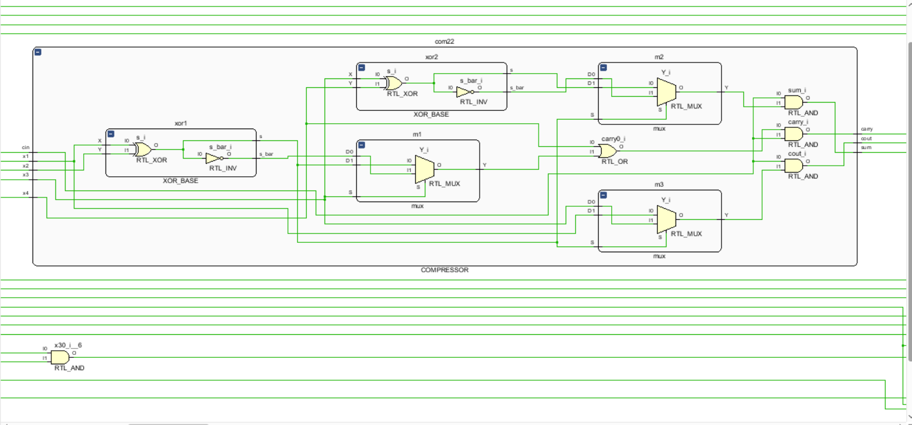
COMPRESSOR

Slide 13
NO OF TRANSISTOR
1.On comparison of exact and approximated 4:2 compressor,
the number of components is increased in the form of AND and OR gates in the proposed structure but the XOR XNOR and MUX circuits of the exact compressor is using increased number of transistors, which increases the power consumption of this circuit and also the multiplier structure.
2. The power consumption and circuit size of the proposed 4:2 compressor has been reduced due to usage of all pass transistor logic based modules like AND, OR, 2T MUX and 6T XOR XNOR and the transistor count of the proposed compressor is reduced to 34 from 52 [2] and 50 [1].

Slide 14
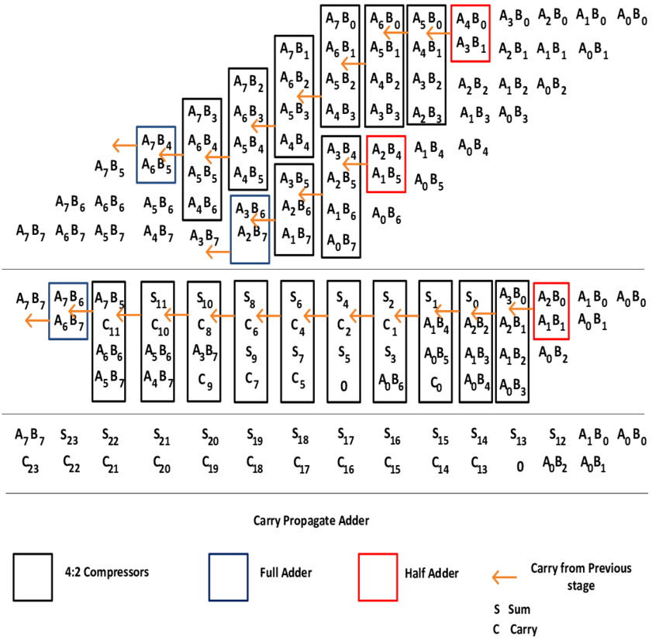
4:2 Compressor using multiplier circuit

Slide 15
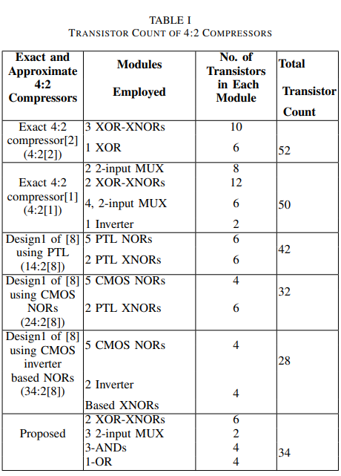
Transistor Count of 4:2 compressors

Slide 16
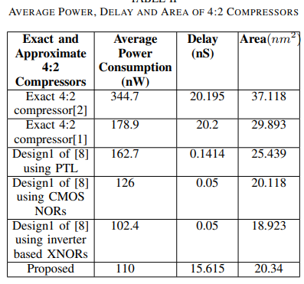
Average Power ,Delay and Area of 4:2 compressors

Slide 17
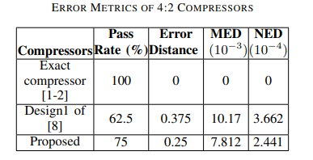
Error metrics of 4:2 compressors

Slide 18
1.MSB's plays important role than LSB's in producing the result, lower order bits of 4:2 compressor are flipped from 1's to 0's which produces an error rate (ratio of no. of inexact outputs to correct outputs) of 25% without loss in the count of number of inputs and outputs.
2.The bits can be flipped either from ‘1 to 0’ or ‘0 to 1’, but in this paper ‘1 to 0’ is chosen to reduce the size of the circuitry. Cout, Carry, SUM bits are flipped by 8, 4, 8 in number respectively. The Sum, Carry and Cout k-maps are shown from

Slide 19
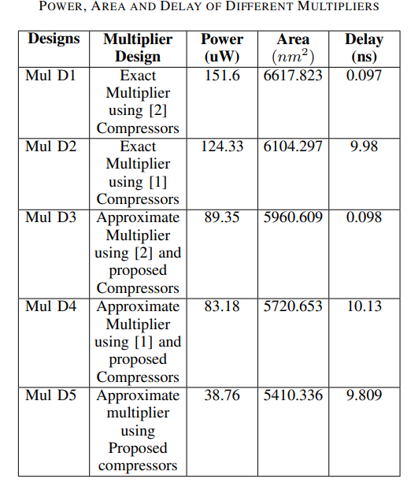
POWER , AREA AND DELAY OF DIFFERENT MULTIPLIERS

Slide 20
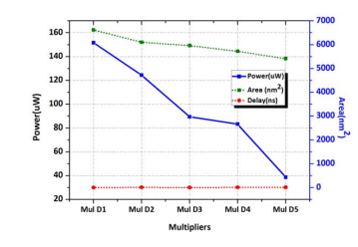
Performance Metrics of Multipliers

Slide 21
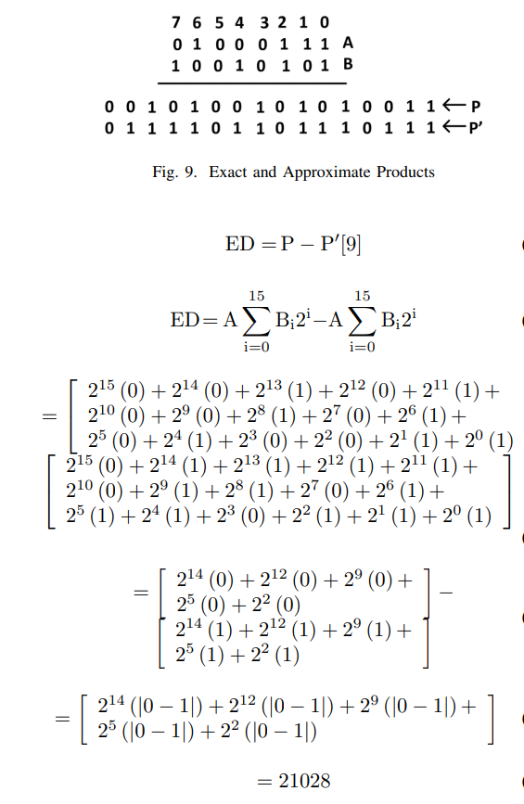
ED,MED OR NED

Slide 22
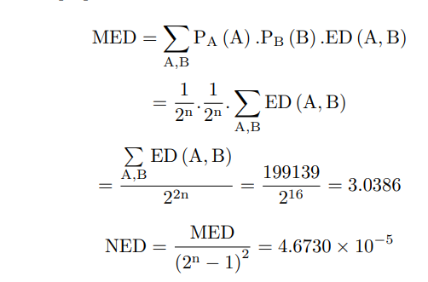
mean error distance (MED) and normalized error distance (NED)

Slide 23
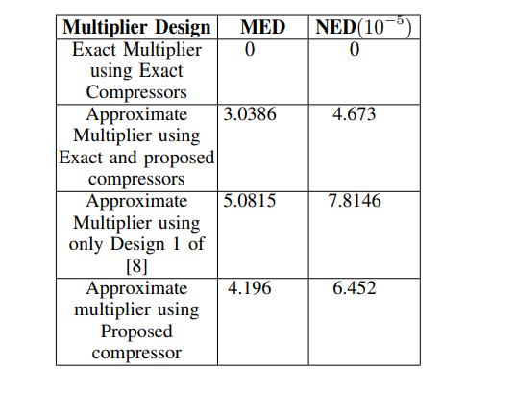
Error analysis of multipliers

Slide 24
CONCLUSION
demonstration of approximate 4:2 compressors employing inexact logic minimization with error analysis has been presented in this paper and the state-of-art 4:2 compressor has been positioned in 8×8 Dadda multiplier.
The comparison results shows that the average power has been diminished for the proposed circuits and have less error rate when considered with the number of transistors.

Slide 25
REFERENCES
Machine Learning Based Power Efficient Approximate 4:2 Compressors for Imprecise Multipliers Lavanya Maddisetti ; JVR Ravindra 2019 32nd International Conference on VLSI Design and 2019 18th International Conference on Embedded Systems (VLSID)
Veeramachaneni et.al., Novel architectures for high-speed and low power 3-2, 4-2 and 5-2 compressors, Proc. Int. Conf. on VLSI Design (VLSID), 2007, pp. 324-329.
Chang et.al, Ultra low voltage, low power CMOS 4-2 and 5-2 compressors for fast arithmetic circuits, IEEE Trans. Circuits Syst. I, Fundam. Theory Appl., 2004, 51, (10), pp. 19851997.
Raphael, D et.al, A Power-Efficient 4-2 Adder Compressor Topology, 15th IEEE (NEWCAS), Strasbourg, France, 2017, pp. 281-284.

